Slide 1
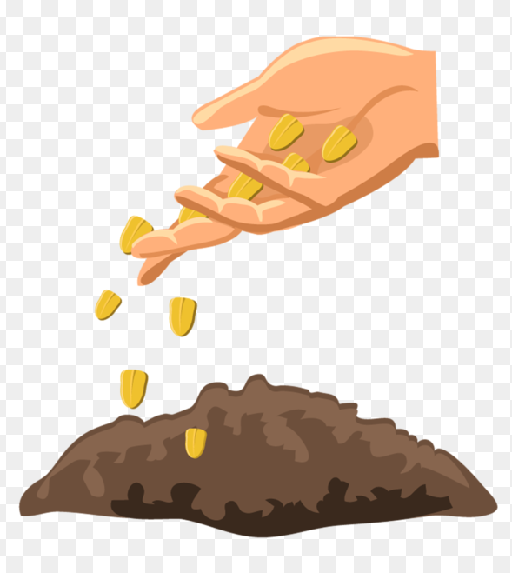
I appear dead before I am alive
Although often quite small, inside my skin a tree can live
I can survive hundreds of years without food or water
I can be as small as dust or as large as a football
Humans and animals eat me
I can fly, swim and hitch a ride
What am I?
Seed

Slide 2
Important Vocabulary
Seed—a structure that can grow into a new plant.
Embryo—a young plant
Germinate—to begin to grow
Flower—a plant structure that makes seeds
Fruit—structure that holds seeds

Slide 3
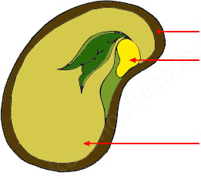
Parts of a seed
Seed coat
Young plant
Food

Slide 4

What does a seed need to grow?
1. Water
2. Space
3. Sunlight
4. Soil

Slide 5
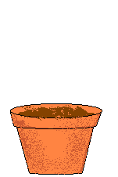
Seeds
*A seed is the start of a new plant
*The have different shapes, sizes and colors
*Flowers make seeds
*Covered in a seed coat to protect and keeps tiny leaves and root inside
*Contains food for the new plant

Slide 6
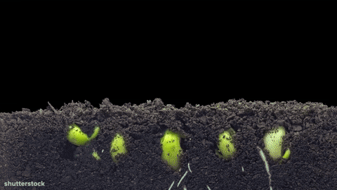
How does a plant grow?

Slide 7
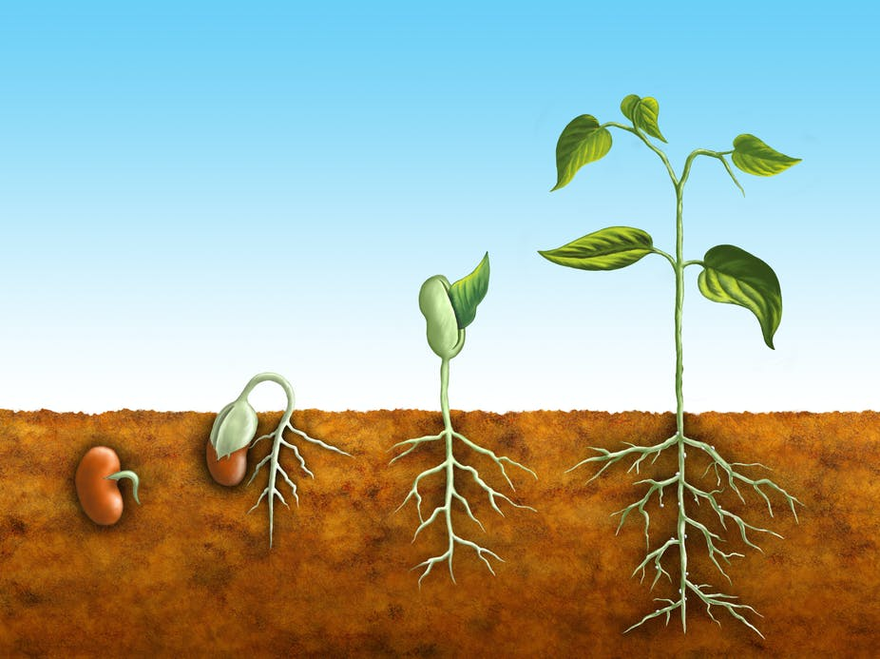
Stage 1
A seed is planted in the soil.
Stage 2
The seed germinates. Roots start growing down into the soil.

Slide 8
Stage 3
The roots grow longer and a stem pushes up out of the ground.
Stage 4
The plant grows leaves and starts to make its own food.

Slide 9
Put the following plant stages in order
*The roots grow longer and the stem pushes up out of the soil.
*Full grown plant. Now it can reproduce and make seeds.
*The seed germinates and roots start growing down into the soil.
*The plant grows leaves and starts to make its own food.
*A seed is planted in the soil.
3
5
2
4
1

Slide 10
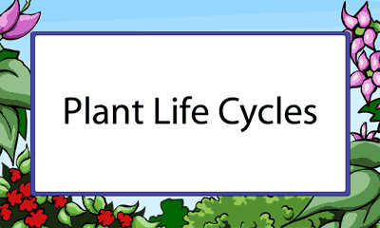
Homework
EVS 1A workbook
Page – 26 , 27 , 28 , 29 and 31

